Slide 1

Prediction of Youth Employment
Machine Learning
Urva Surti (A20505142)
Sudarshan Thakur (A20522408)
Bandhavi Parvathaneni (A20516844)

Slide 2
Introduction
This project focuses on placement of a college student considering the parameters/features such as Highschool percentage marks, graduation gpa, salary expectation, work experience, stream the student belongs to, the board in which he/she studied etc.
The project tests various machine learning algorithms like Gaussian Naive Bayes, Random Forest, XGBoost and K Nearest Neighbours. The best performing algorithms were chosen for stacking and creating a new hybrid model. Based on the result the student can decide about how he/she has to go around for the preparation of campus placements.
With the help of Machine Learning Algorithms and Prediction Modelling, candidates just by providing some data can find out whether they’re employable or not and be prepared for the future by enhancing their skills in the domain they wish to be employed into.

Slide 3
EDA
We have used EDA to extract insights from the data. EDA can also be useful in finding different patterns within the data and also help in detecting and dealing with the outliers which are present within the data yet hard to find. The collected data is preprocessed to eliminate/replace the null and missing values from the data. Some inferences from EDA
1) The students with no work experience have very less placements whereas the students with some work experience are placed
2) Most of the placed students belonged to Science and arts.
3) Majority of the students have no work experience, whereas very small percentage has some sort of work experience.

Slide 4
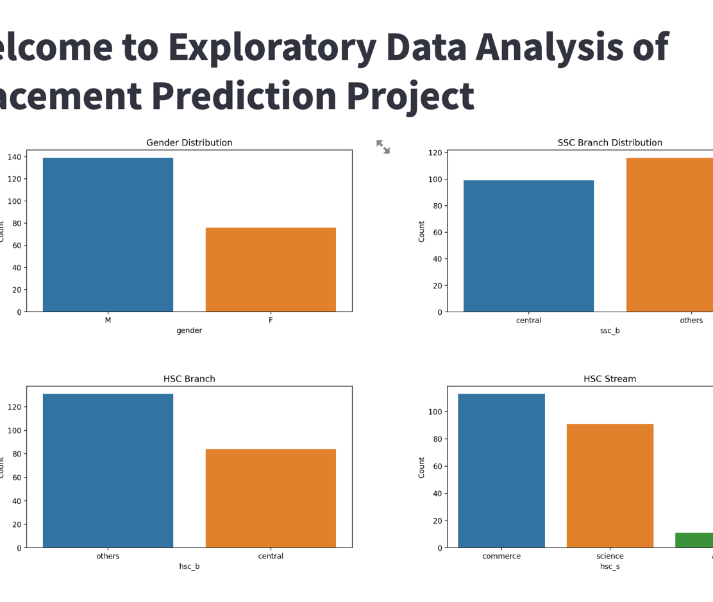

Slide 5
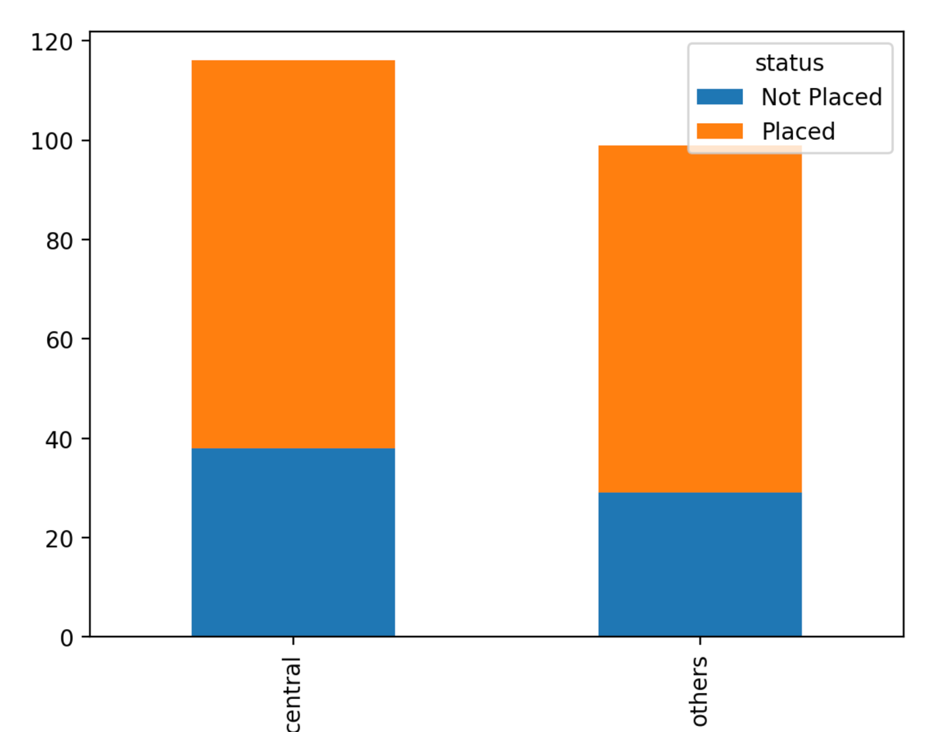
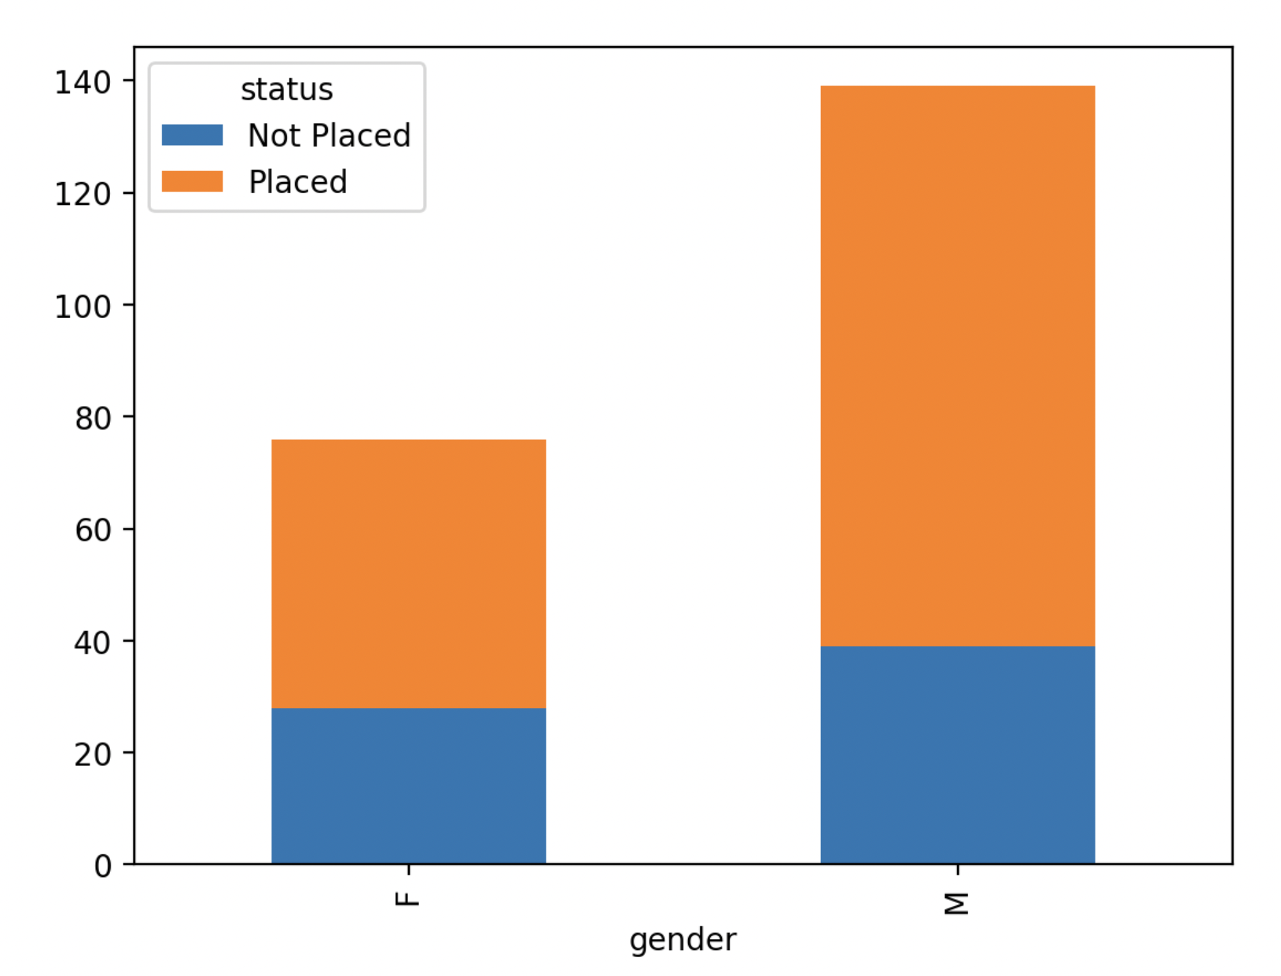

Slide 6
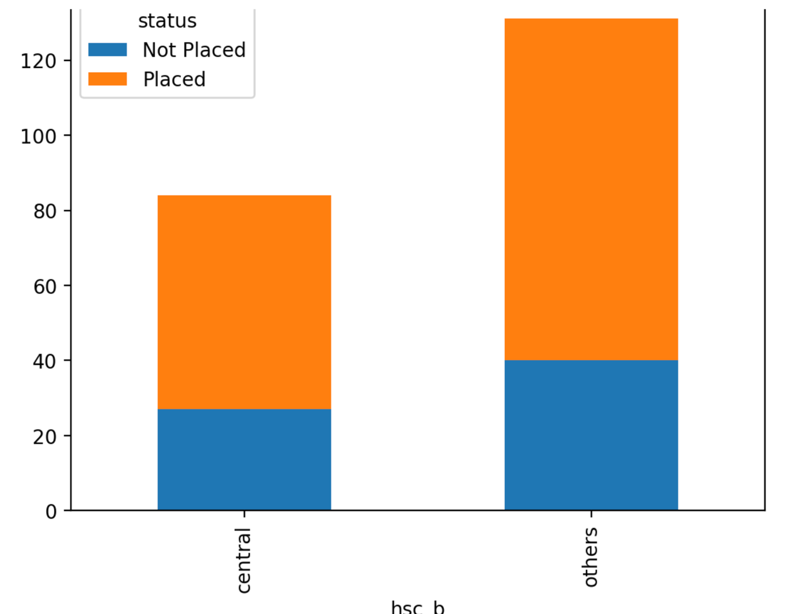
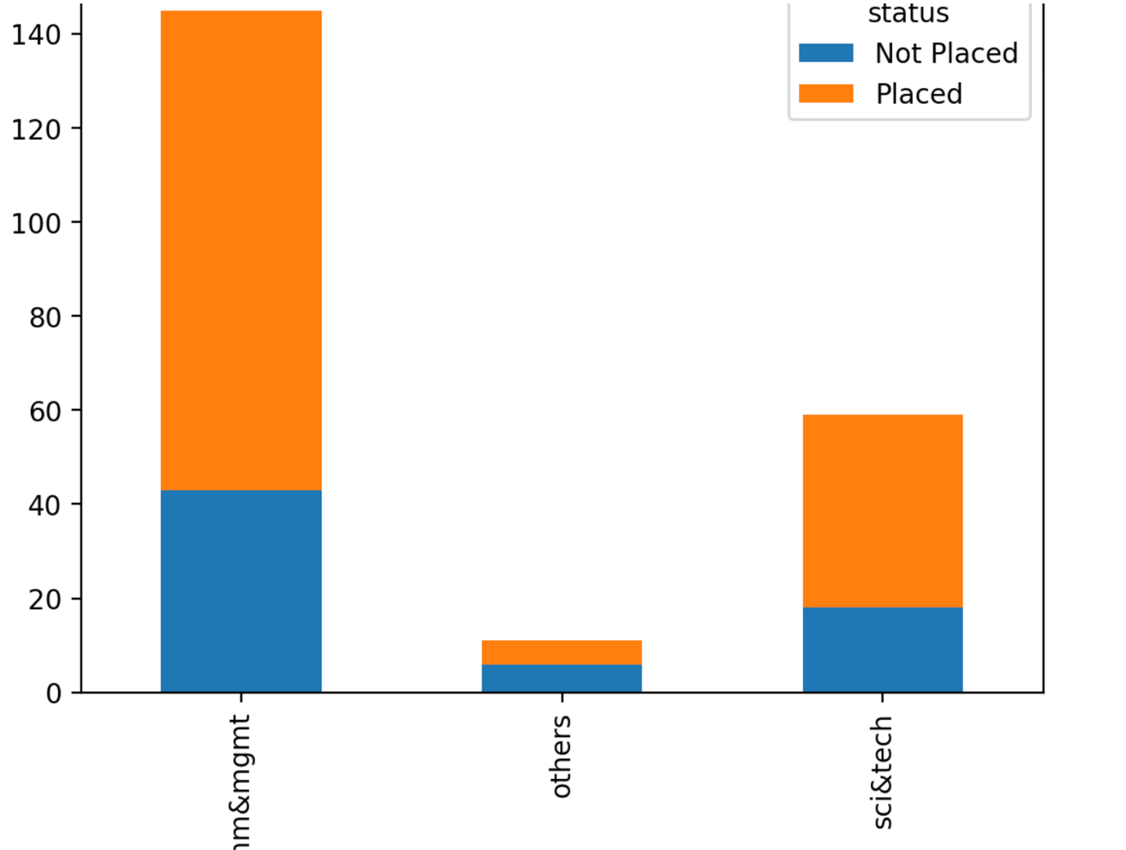

Slide 7
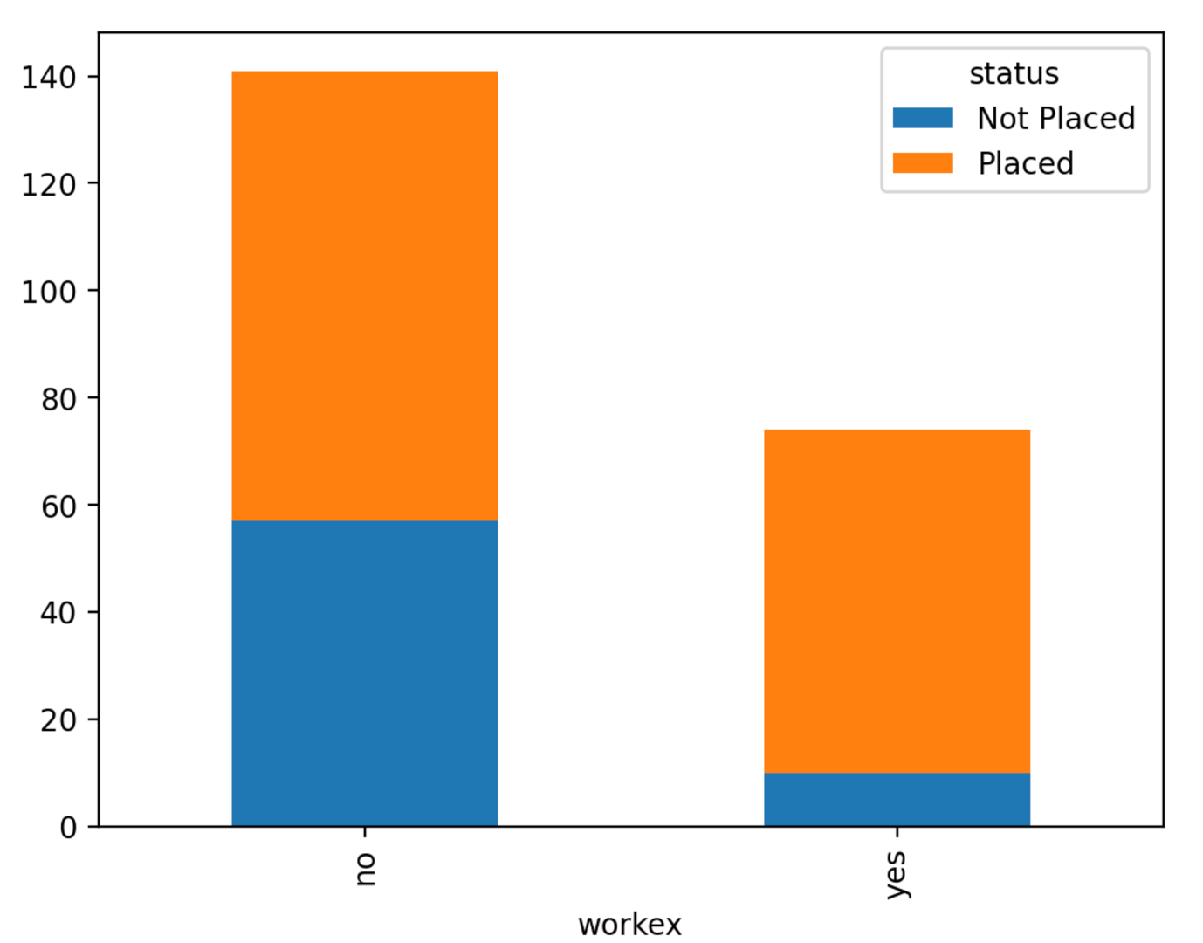

Slide 8
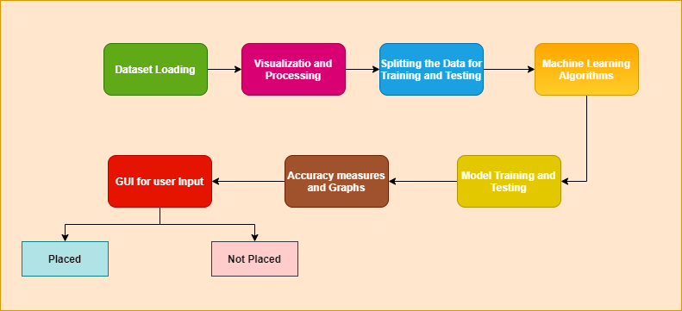
System Architecture

Slide 9

DataSet
The dataset used in the research is from an online source i.e. Kaggle which consists of 15 attributes and 215 student records. The candidates are classified into two categories i.e. placed and not placed

Slide 10
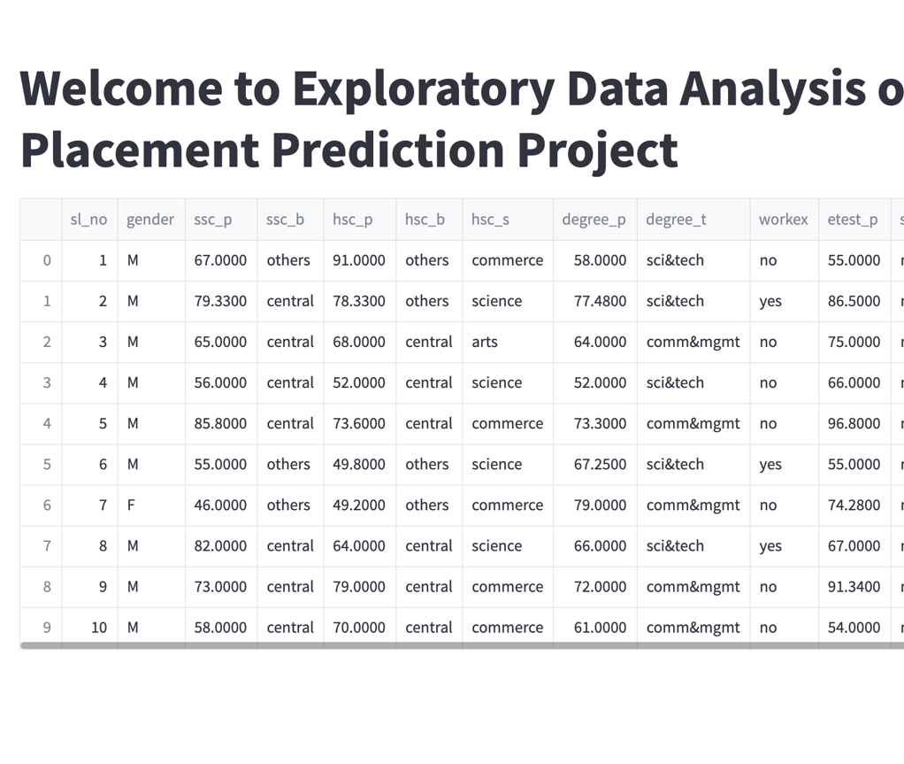

Slide 11
Methodology
The parameters/features such as Highschool percentage marks, graduation gpa, salary expectation, work experience, stream the student belongs to, the board in which he/she studied etc are used as an input data to the model.
The machine learning model inputs the features from the user and gives out a result in the form of placed and unplaced.
We have tested various machine learning algorithms like Gaussian Naive Bayes, Random Forest, Support Vector Machine and K Nearest Neighbors.
The best performing algorithms are chosen for stacking and creating a new hybrid model.

Slide 12
Algorithms
We have tried implementing different algorithms and calculating their accuracy and stacking up the algorithms with high number to accuracy to create our model. The algorithms used for model building:
Gaussian Naïve Bayes
K-Nearest Neighbours Classifier
Random Forest Classifier
XGBoost
The performance evaluation was done for all the above algorithms using metrics like accuracy, confusion matrix, misclassification rate, recall. Out of all the 4 algorithms the XGBoost had the highest accuracy of 89.46%.The lowest accuracy was given by Random forest algorithm which was 83.07%.
The hybridized algorithm was creating by using the stacking classifier from the MLX tend library and the three algorithms used for stacking were
XGboost
KNN
Gaussian NB
Further this model was tested for performance, and it was observed that the stacked model gave an accuracy of 93.384% which was good enough for deployment.

Slide 13
Previous Work Methods
Previously various models were deployed using single algorithms such as logistic Regression, Gaussian naïve baye’s with accuracy of about 85-90%. We have stacked 3 algorithms and have created a hybrid model for our project.

Slide 14
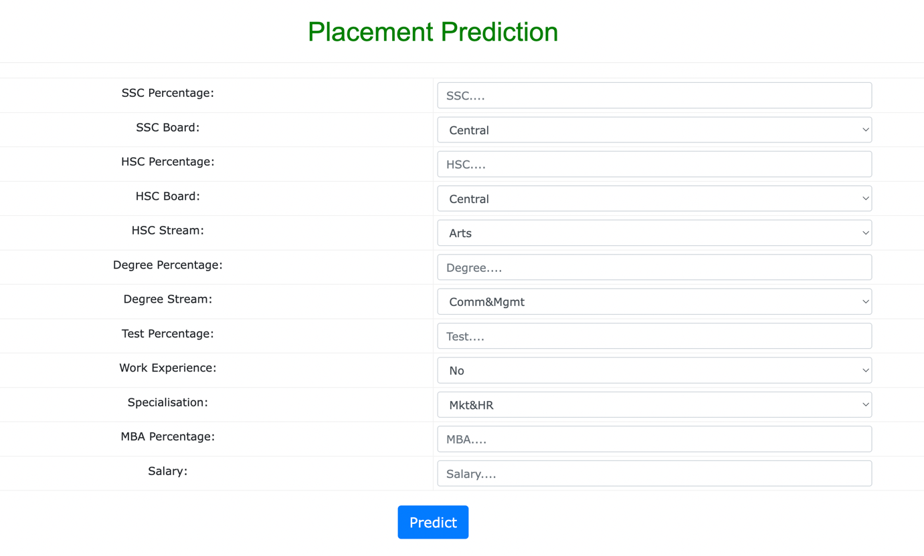
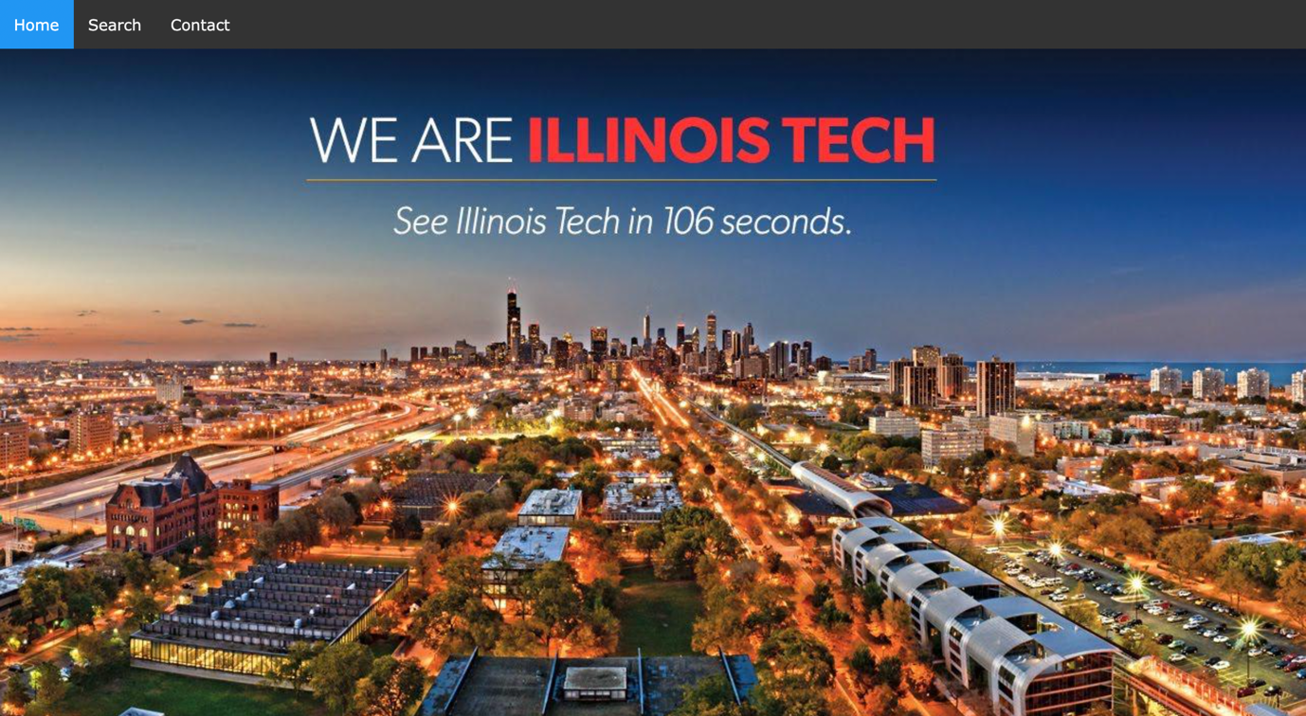
Screenshots

Slide 15
Conclusion
We have developed a model which can assist students to predict whether they’ll be able to get a job or not using various inputs dealing with student’s academic record and the field/domain the student comes from. The EDA performed during the making of this project provided our team some important insights within the data itself which will be further used for research purpose. .The hybrid model provides a better performance compared to the work of previous researchers we can say that we have achieved our goal.
Since, Machine Learning is quite a vast field there will be researchers coming up with new algorithms which would provide better results and performance compared to the existing work so this process is an ongoing one

Slide 16
Future Work
In the future, the researchers must focus more on gathering more diverse features within the data and not just focus on percentage of marks which are more of a qualifying criteria for a particular student to participate in a placement drive for an organization. Having a dataset with more volume can also impact the result in several ways. The data should also focus on students' other achievements and also nonacademic roles/achievements they were a part of which will allow the research to take a new outlook in predicting students’ employment. Hybridization of other algorithms apart from the ones used in this paper can also be done to obtain better results

